Slide 1
Coursera Capstone Project
By: Alissa Stuart

Slide 2
Introduction/Business Problem
Our client, a bottled water distributor, has an established role in the market of Toronto. He is the top supplier of bottled water with more than 1500 clients in the Toronto neighborhood. His main clients are hotels, coffee shops, restaurants, and bars. Currently, the products are stored in a big central warehouse outside of Toronto and distributed to different venues daily. The main problem with this is that the distribution of the product becomes increasingly time-consuming and costly. Our client wants to increase efficiency and reduce the cost by building 5 smaller warehouses in Toronto to serve his clients locally. This approach will reduce the time to spend on roads, fuel cost and become more environmentally friendly.
To do so our client asked us to find the best 5 locations in Toronto at which he can build warehouses to create smaller distribution clusters. After this, he will try to build his warehouses at the center of those clusters to minimize the distance to each venue.

Slide 3
Data
The data required are the locations of hotels, coffee shops, bars and restaurants in Toronto. To gather the data, we will use the locations of all neighborhoods in Toronto gathered from Wikipedia. Based on these locations we will gather the locations of all venues in these neighborhoods from foursquare. We will filter the data to acquire the locations of the targeted venues. To inspect the data, we will use the folium library to extract the map of Toronto and visualize the locations of the venues on the map.
A k-means algorithm will be applied to the locations features to define the 5 clusters of venue. The locations of the warehouse will be defined as the centroids of the clusters. Again, to visualize the map of Toronto, the 5 clusters and the locations of the warehouses we will use the folium library.

Slide 4
Methodology
To define the location of each warehouse, we chose to use the k-means algorithm. By default, this algorithm minimizes the distance of each point from the centroid to the cluster. As a result, the output of the k-mean algorithm is a set of clusters whose points are lying at the minimum distance from the determined centroids.
As an input, we used the set of locations (lat, long) of venues of interest. In this example, the category of each venue is not required in the algorithm. All venues belonging to hotels, bars, restaurants and coffee shops are included in the list. The locations of hotels, bars, restaurants and coffee shops are shown as they were gathered from the foursquare database in figures 1, 2, 3 and 4. A total of 249 coffee shops, 961 restaurants, 81 hotels, and 172 bars were found and used in the k-means algorithm.

Slide 5
Methodology (continued)
Table 1: Sample of Restaurants Locations in Toronto

Slide 6
Methodology (continued)
Table 2: Sample of Bars Locations in Toronto

Slide 7
Methodology (continued)
Table 3: Sample of Hotels Locations in Toronto

Slide 8
Methodology (continued)
Table 4: Sample of Coffee Shops Locations in Toronto

Slide 9
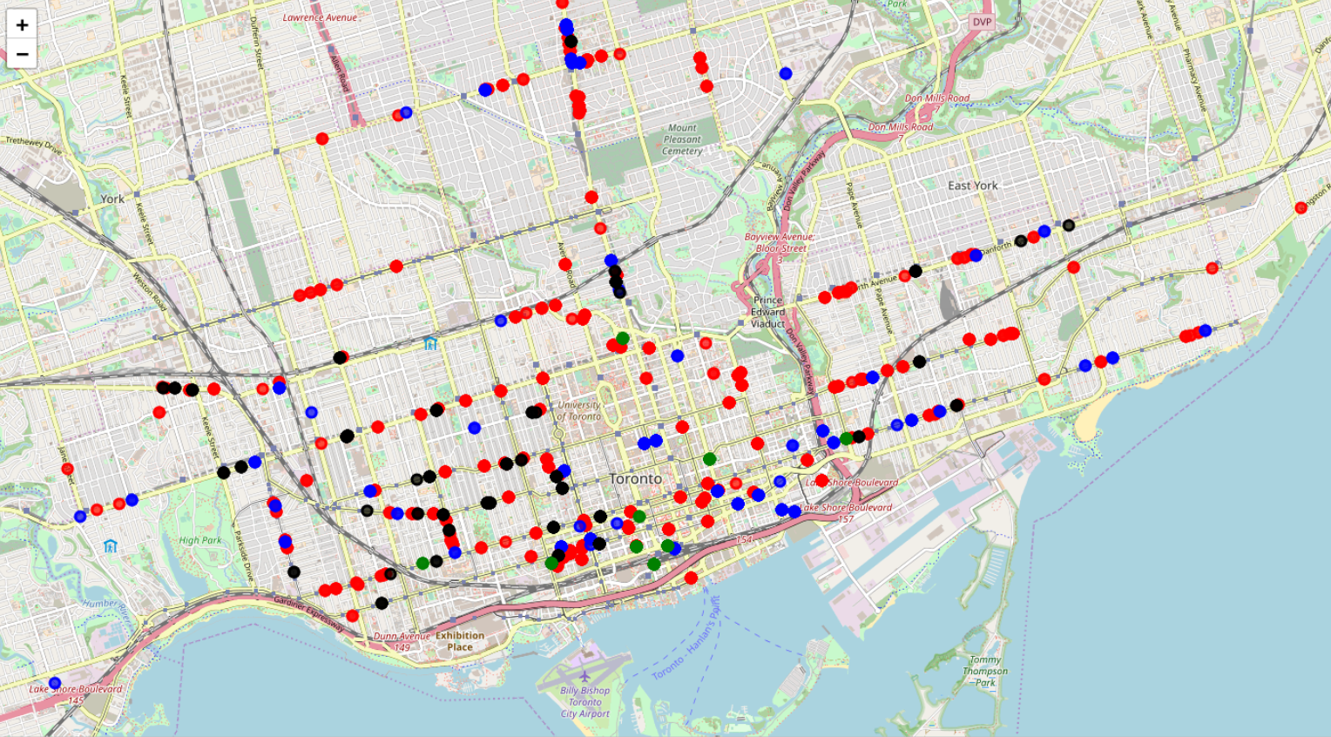
Results
Figure 1: Locations to which Company Delivers its Product
Green – Hotels Blue – Coffee Shops
Red – Restaurants Black – Bars

Slide 10
Results (continued)
Figure 2: The 5 Clusters of the Venues Indicated by Different Colors.

Slide 11
Results (continued)
Cluster | Location Center (latitude) | Location Center (longitude) | Mean Radius (km) | Area (km²) | Number of Venues | Density
Red | 43.651 | -79.406 | 3.773 | 44.729 | 367 | 8.204
Magenta | 43.654 | -79.378 | 3.575 | 40.155 | 502 | 12.501
Green | 43.670 | -79.334 | 5.430 | 92.624 | 191 | 2.062
Blue | 43.707 | -79.398 | 4.687 | 57.246 | 227 | 3.965
Orange | 43.658 | -79.448 | 6.188 | 120.314 | 176 | 1.463
The mean radius was calculated for each cluster. The location of the warehouse was defined by the cluster centroids in the k-mean algorithm. Moreover, the number of venues in each cluster was extracted and used to define the density in each area. The results are shown in the table above.

Slide 12
Results (continued)
Figure 3: Clusters Area

Slide 13
Discussion
From the results, we can see the variety in the distribution of venues in Toronto city. As seen the two central clusters in the middle of the city contain at least a double number of hotels, restaurants, bars and coffee shops than three other clusters. For this reason, their areas are smaller than those of the other three clusters. Based on this observation we suggest:
The size of the warehouse at the red and purple areas be at least double than the size of the other warehouses
The number of employees at the warehouse at the red and purple areas should be at least double than the in the other warehouses
The number of tracks in each warehouse should correlate to the number of venues in each cluster

Slide 14
Conclusion
The main problem in this work is the definition of the locations where 5 warehouses can be built to improve the process of bottled water distribution in the city of Toronto. Our approach was to devise Toronto in 5 different subregions. The criterion used for this division was the density of venues of customer venues in the entire city. The center of each subregion was estimated using the k-means algorithm. The standard deviation of each cluster was used to define the area containing the venues to which the warehouse must provide its products. Based on the results, we are able to define the location of the warehouses, their size, number of employees in each warehouse and the number of trucks required.

